Slide 1
A USERS Guide to COVID Testing
Brian Locke,, MD. Chief medical Resident
Notes:
This is where we’re at now… this has been the major clinical question on most of our ward services, where there are still many more rule-outs than confirmed cases.
WARNING, NUMBERS – but no more than required to understand this. Try not to let the math paralyze your thinking. Some people are more comfortable representing their thoughts with numbers, but you’re all capable of thinking.
This is a bit of a rabbit hole…
Goal:
-Clarify what is known, and what is unknown
-Give a framework for acting under this uncertainty
-Highlight some pitfalls.

Slide 2
Nasopharyngeal PCR
@UtahIMCMRS
Notes:
Note: clinically correlate = pre-test probability
As you’ll hear, “we don’t know the sensitivity” is the common answer to how good this test is… unfortunately, we need to make decisions now – so we’re still using the test even without knowing. Here’s ‘going beyond that we don’t’ know the sensitivity’
Unfortunately, I’m not going to give an algorithm, because it’s going to be wrong.

Slide 3
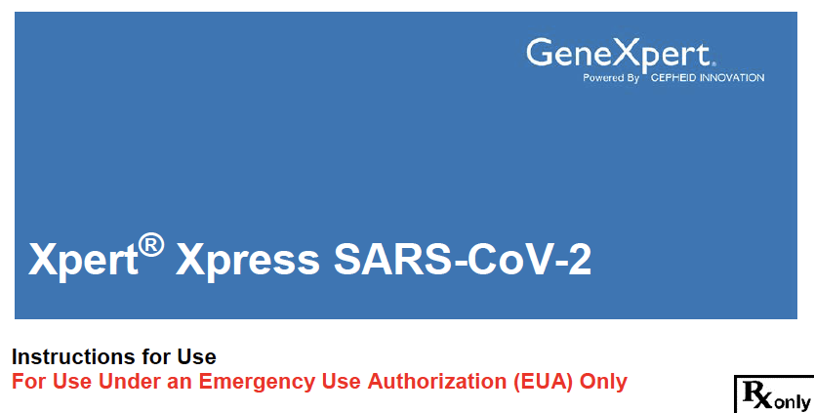
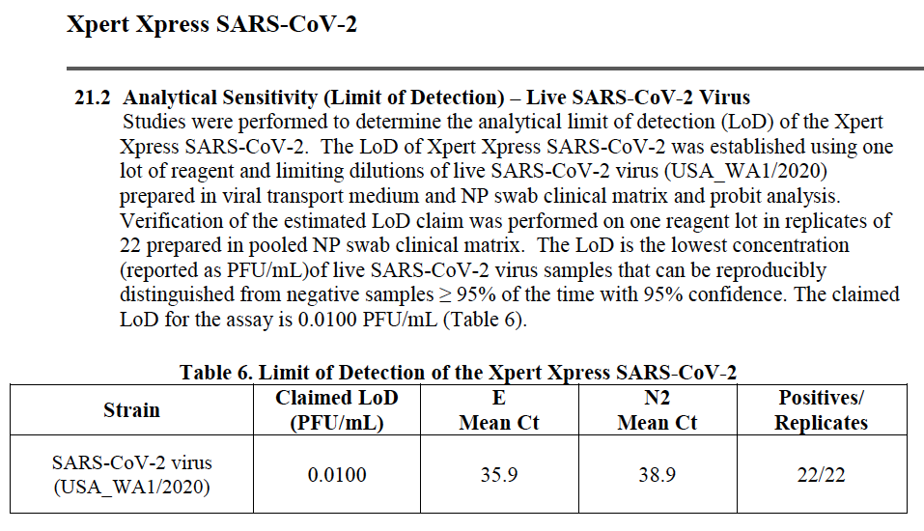
Test characteristics sensitivity
Radiopedia, https://www.fda.gov/media/136314/download
@UtahIMCMRS
Notes:
Sensitivity / Specificity = mostly measure how good the test is.
Sensitivity = of the people who actually have the disease, how many test positive= True Positive Rate.
Specificity = of people who don’t actually have the disease, how many test negative = True negative rate
SPecificity rules in, SeNsitivity rules OUT – not exactly true. But we’ll return to that.
Specificity = for nasopharyngeal PCR, accurate and not much ‘colonization’ so we’ll assume its very high. Contamination could cause false negative
Analytic sensitivity vs Clinical sensitivity: https://jamanetwork.com/learning/audio-player/18365648
Analytic sensitivity = what is reported in test approval papers. They run the test on a test group and on a known + and known SAMPLES to estimate false + and negative.
Essentially, ‘how good is the test at finding virus, if the virus is in the sample collected).’ and how good is at at not finding the virus in samples where no virus is present.
Of course this is not directly what we’re interested in, as two other key pieces of information before it’s used: how reliably the sample is collected, and is the virus in the fluid sampled during the disease.

Slide 4
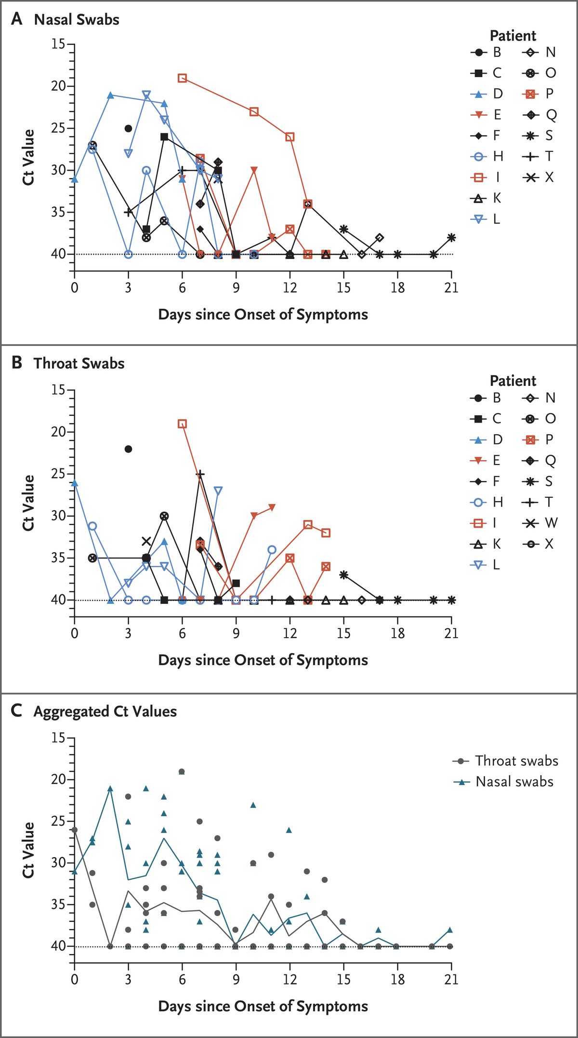
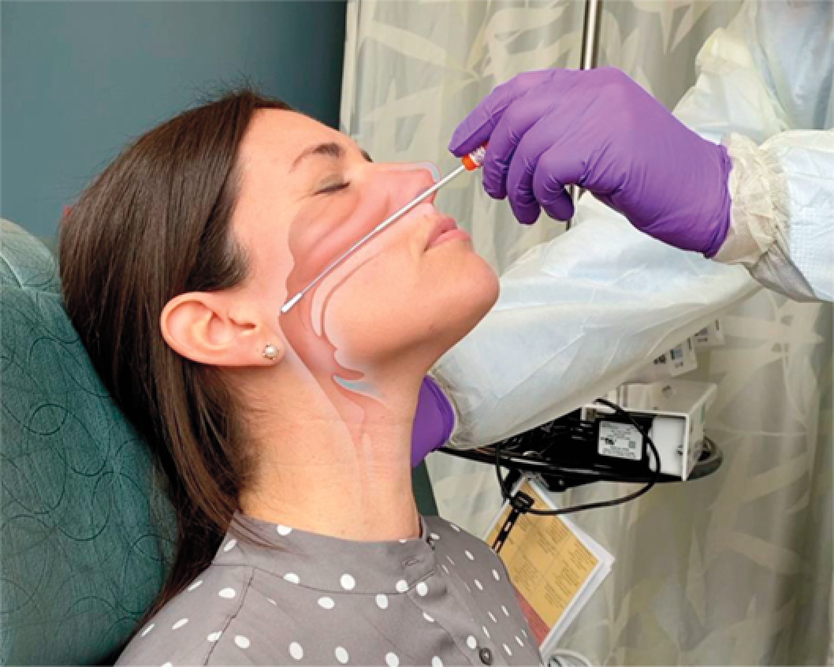
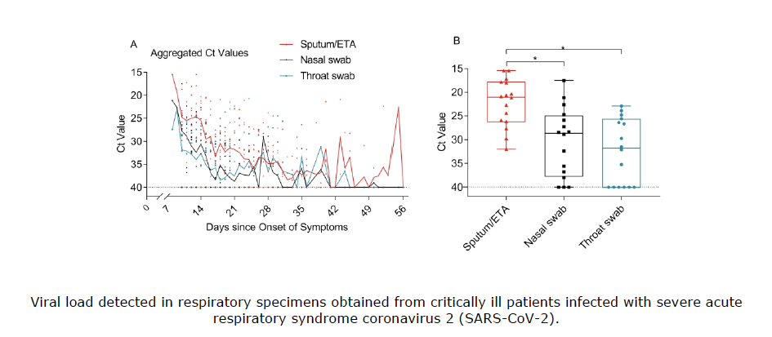
Clinical Sensitivity
Better than 85%
(probably much better)
FM Marty et al. N Engl J Med 2020 // L Zou et al. N Engl J Med 2020;382:1177-1179 // DOI 10.1164/rccm.202003-0572LE
@UtahIMCMRS
Notes:
1. What is our outcome reference? Infectiousness? Disease? ”Whats the gold standard”
Differs by time in illness (esp very early, or very late) -> viral dynamics
Differs by site of collection (e.g. LRTI might not as reliably have upper respiratory virus as someone with URI symptoms) Differs by collection technique and pre-laboratory processing (where difference between rapid and traditional) - flocked swab, universal transport media (= what you put it in to keep the RNA from decomposing)
Analytic sensitivity of both rapid tests and full PCR tests are both good -> these other factors are what matters.
https://www.finddx.org/covid-19/dx-data/
=collaboration about test information.

Slide 5
Sensitivity vs positive predictive value
Depends on!
@UtahIMCMRS
Notes:
How do we use this? Returning to the confusion matrix
Sensitivity and specificity = can’t be directly used (because we need to know the true presence or absence of the condition.. Which is what we’re interested in!)
Sensitivity = of the people who actually have the disease, how many test positive= True Positive Rate.
So, how do we use this? PPV and NPV = based, we KNOW the test result (=prediction), how likely is it a true positive or a false positive?
However, this depends on a population prevalence, and gives us an average across the population = can give population level information, but difficult to apply to individual patients, who likely have characteristics that differ from the ‘average’ in a population.
https://calculator.testingwisely.com/playground/5/90/90/positive

Slide 6
Likelihood ratios patient-level metric
Ranji SR, Shojania KG, Trowbridge RL, Auerbach AD, Impact of CT on PE Diagnosis. J. Hosp. Med 2006;2;81-87. Jack Penner, MD - https://clinicalproblemsolving.com/2020/02/09/clinical-reasoning-corner-likelihood-ratios/
@UtahIMCMRS
Notes:
Note: this is all done in odds
I’m not just torch

Slide 7
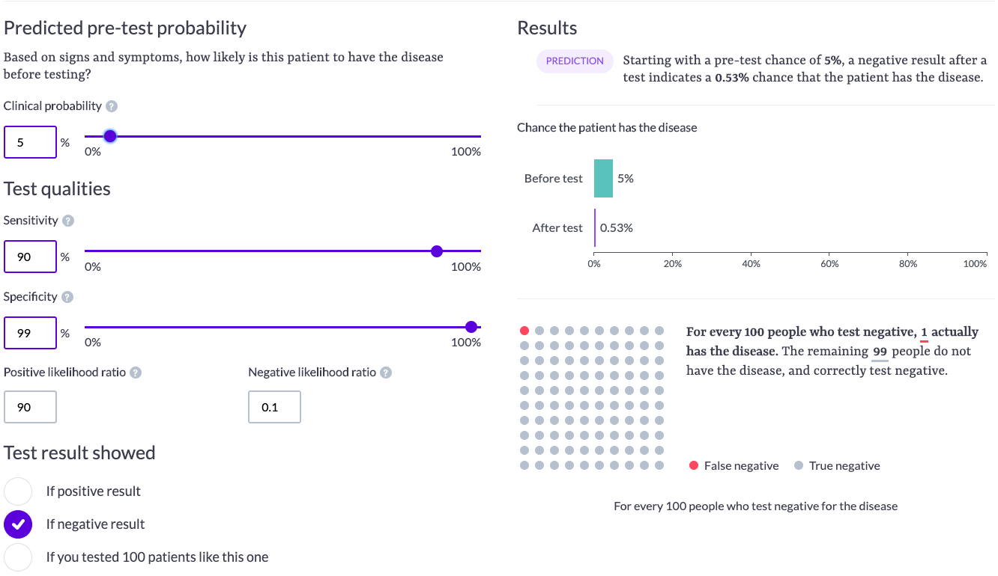
Two examples CoVID rule outs
Case 1
Guesses! Play around with your own
https://calculator.testingwisely.com/playground/5/90/90/all
@UtahIMCMRS
Notes:
1:19 odds = pretest. - using this as a starting point because it’s about the overall positivity rate in UT
* negative LR of 0.1 (if we assume se 90%, spec 99%)
Post-test odds 1:190
Note: I’m just throwing in a 90% sensitivity as a ball park, when this data is available, feel free to update.

Slide 8
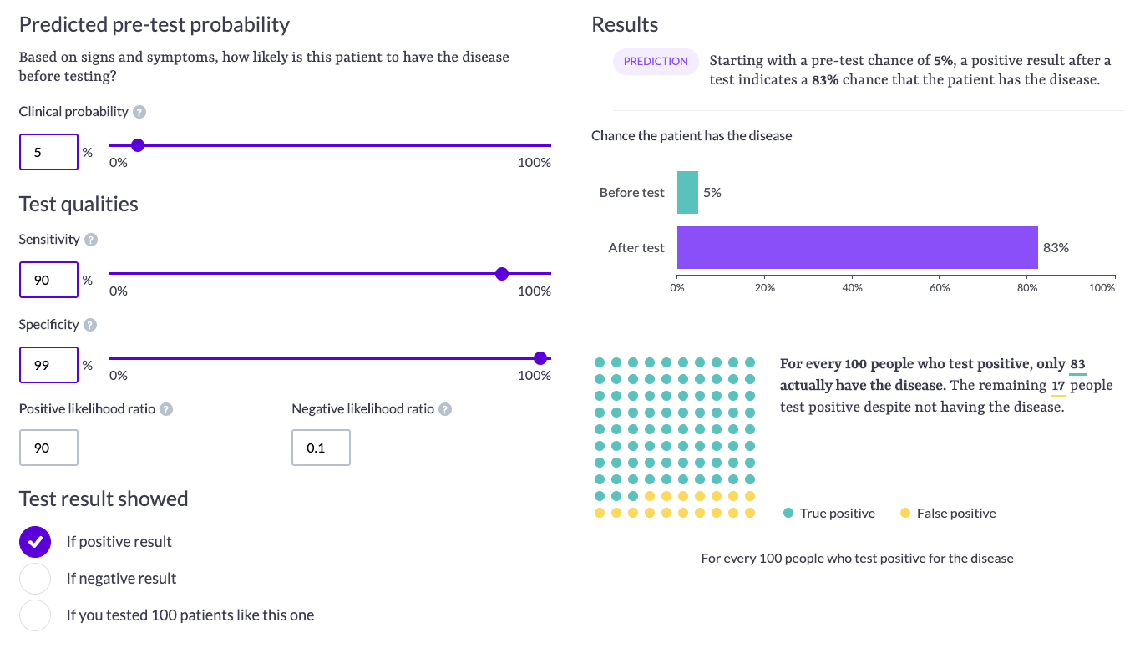
Two examples CoVID rule outs
Case 1
https://calculator.testingwisely.com/playground/5/90/90/all
@UtahIMCMRS
Notes:
1:19 odds = pretest
Times positive LR of 90 (if we assume se 90%, spec 99%)
Post-test odds 90:19 odds = 83% probability

Slide 9
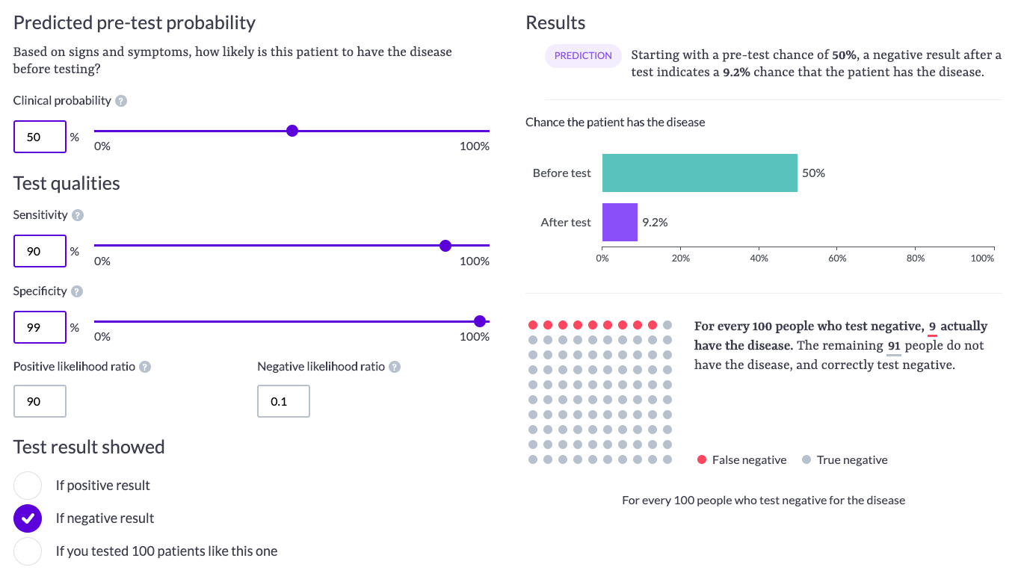
Two examples CoVID rule outs
Case 2
https://calculator.testingwisely.com/playground/5/90/90/all
@UtahIMCMRS
Notes:
Say a super suspicious case comes in (or you’re in NY during peak outbreak) 1:1 odds = pretest
negative LR of 0.1 (if we assume se 90%, spec 99%)
Post-test odds 1:10 odds = 9% probability

Slide 10

Post test prob: What do you do with it?
‘Testing threshold’ Depends on how bad it will be to be wrong!
https://clinicalproblemsolving.com/2019/10/23/clinical-reasoning-corner-pre-and-posttest-probability-jack-penner/
@UtahIMCMRS
Notes:
What do you do with the post-test probability? = fundamentally gambling, we never know with absolute certainty, but we need to make decisions anyway. Easier to decide the stronger or weaker our hand is.. But where’s the break even point?
Treat = above the treatment threshold – we have enough certainty that we should act
Toss = below the testing threshold = we have sufficiently excluded the diagnosis. Knowing that we can never be 100% sure, we’ve decided this is unlikely enough.
2% is the number in the literature for all comers with PE.
This is patient specific!
Consider 3 scenarios:
30 y/o graduate student who lives alone
30 y/o healthcare worker
85 y/o with numerous comorbidities
*50 y/o intubated in the ICU (this also has more to do with the treatment threshold.)

Slide 11
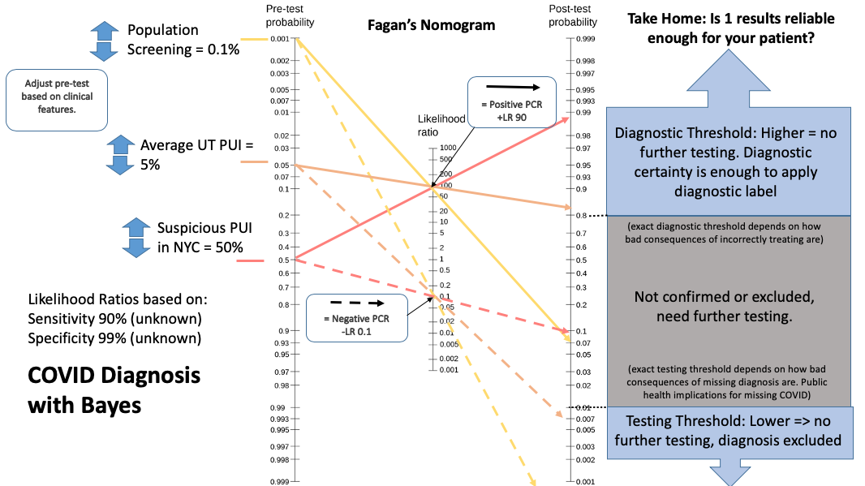
summary: Fagan’s nomogram.
@UtahIMCMRS
Notes:
Fagan Nomogram
To summarize – while we don’t know the exact sensitivity / specificity of the test, and it depends on collection method, site of sampling, and course of disease
Consider the Pretest probability (how likely is this to be COVID) and testing threshold (how bad will it be if I’m wrong)

Slide 12
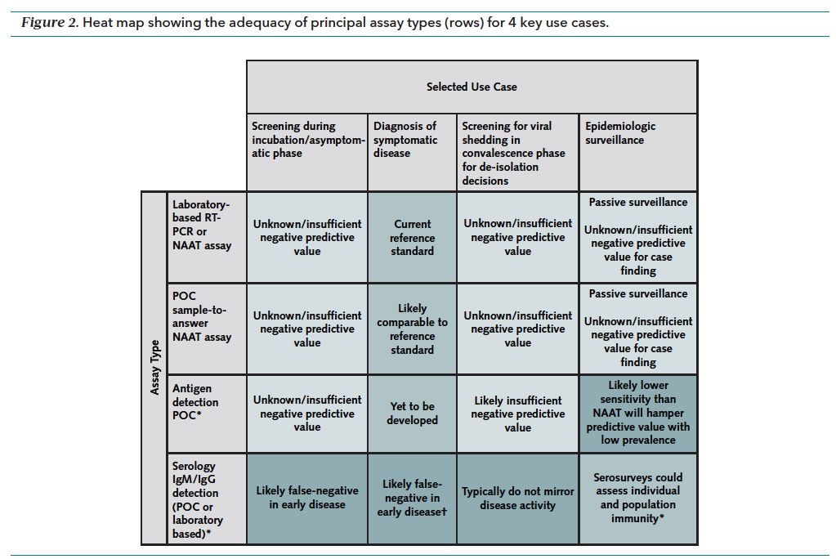
Use cases: Preview for Thursday
@UtahIMCMRS
Notes:
Look forward to Thursday – serologies
Different use cases need different serologies

Slide 13
CT Scans
For COVID?
@UtahIMCMRS
Notes:
Note: clinically correlate = pre-test probability

Slide 14
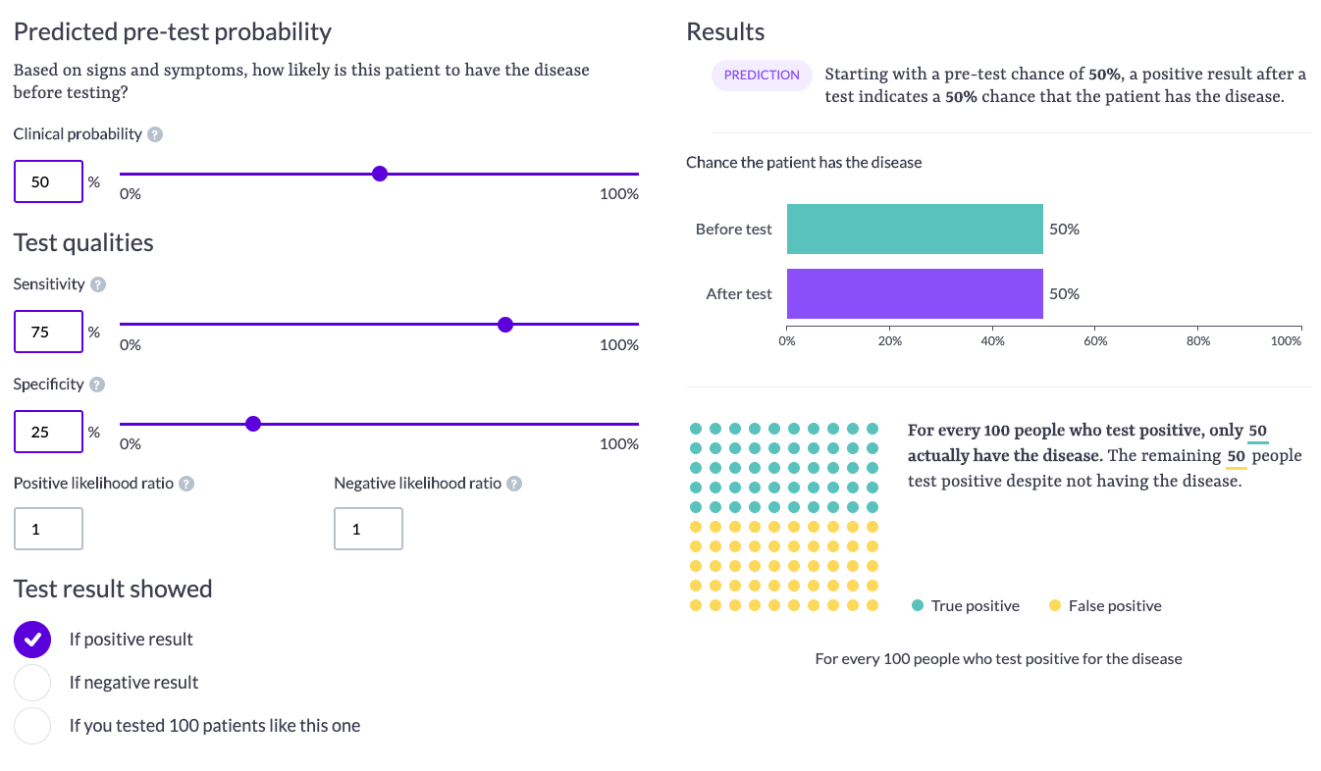
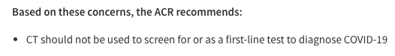
CT Scans and the rule of 100
https://lukeoakdenrayner.wordpress.com/2020/03/23/ct-scanning-is-just-awful-for-diagnosing-covid-19/
@UtahIMCMRS
Notes:
CT scan – details of Luke Oakden-Raynor’s presentation, and summary of the society recommendations - https://lukeoakdenrayner.wordpress.com/2020/03/23/ct-scanning-is-just-awful-for-diagnosing-covid-19/
SPecificity rules in, SeNsitivity rules OUT – not exactly true.
Rule of 100 (on sens-spec)
If sensitivity + specificity sums to 100, no information is added by the test.
CT does have a role – it can suggest an alternative diagnosis (example, exclude LRTI as cause of dyspnea)
Helpful to explain whether dyspnea is from an airspace dz of the bilateral lungs (e.g. r/o PE, ventilation trouble from other causes…) but not terribly useful for differentiating things closest on the differential.

Slide 15
summary: Fagan’s nomogram.
Correlate clinically = What was your pretest probability?
@UtahIMCMRS
Notes:
We deride the radiologists about ‘correlating clinically’
However, just like deriding the surgeons about liking LR, medicine is wrong on this, again. You need to correlate clinically.

Slide 16
Symptoms and Risk Factors
@UtahIMCMRS

Slide 17
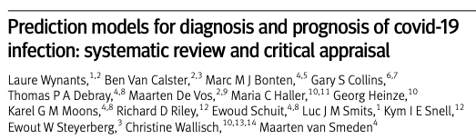
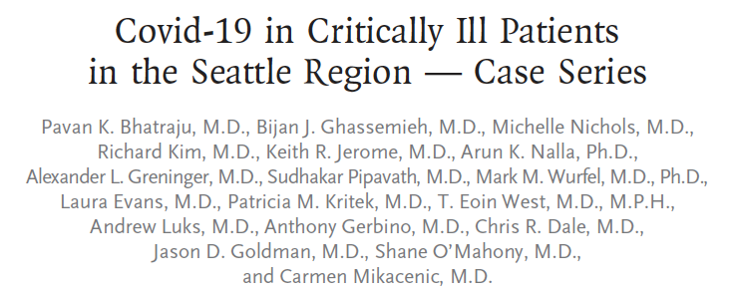
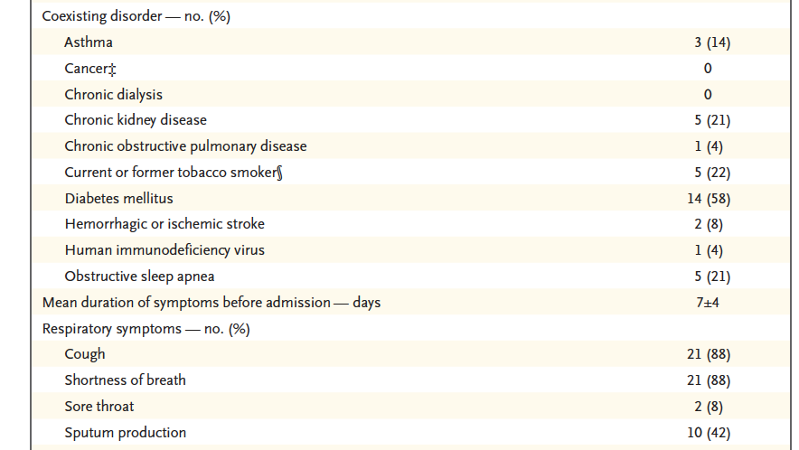
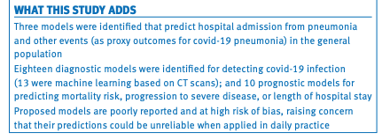
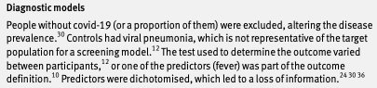
Risk factors a word of caution
@UtahIMCMRS
Notes:
HTN and Obesity…. Are they really risk factors?
Given I know someone has COVID, what’s the probability they have a risk factor?
Given I know someone has a risk factors, what’s the probability they have COVID?
Can’t swap those (transposing the conditional - https://twitter.com/raj_mehta/status/1248454009129545731?s=20)– estimates of the first might be off if patients with a risk factor are more likely to be tested, or more likely to be moved to an ICU (for the WA example). Longer explanation - https://twitter.com/LucyStats/status/1248307278404554759?s=20

Slide 18


